Slide 1
A hybrid deep transformer model for epileptic seizure prediction
Paper Link : https://ieeexplore.ieee.org/abstract/document/10088398
Nithin Thota
700758689
Neural Networks and Deep Learning

Slide 2
MOTIVATION
Epilepsy affects over 70 million people worldwide. Accurate prediction of seizures can significantly improve the quality of life for patients. Current methods struggle with either high false positive rates or low sensitivity. There is a pressing need for a robust and accurate seizure prediction system to help prevent seizures before they occur.

Slide 3
EPILEPSY
Epilepsy is a neurological disorder in which a patient undergoes frequent seizures.
Epilepsy is a very common neurological disease that has affected more than 65 million people worldwide.
In more than 30 % of the cases, people affected by this disease cannot be cured with medicines or surgery.
However, predicting a seizure before it actually occurs can help in its prevention. Therefore, it is extremely important to predict the subsequent seizures before they occur so that seizure can be prevented with the help of medication.

Slide 4
PROBLEM STATEMENT
Studies have observed that abnormal activity inside the brain begins a few minutes before the start of a seizure, which is known as preictal state. Many researchers have tried to find a way for predicting this preictal state of a seizure but an effective prediction in terms of high sensitivity and specificity still remains a challenge.

Slide 5
OBJECTIVES
Implement a hybrid framework combining feature extraction and deep learning.
Utilize Fourier Transform for effective feature extraction.
Validate the model using the CHB-MIT database.
Employ a deep transformer model for seizure prediction.
Notes:
In this paper they used these 4 objective methods 1)

Slide 6
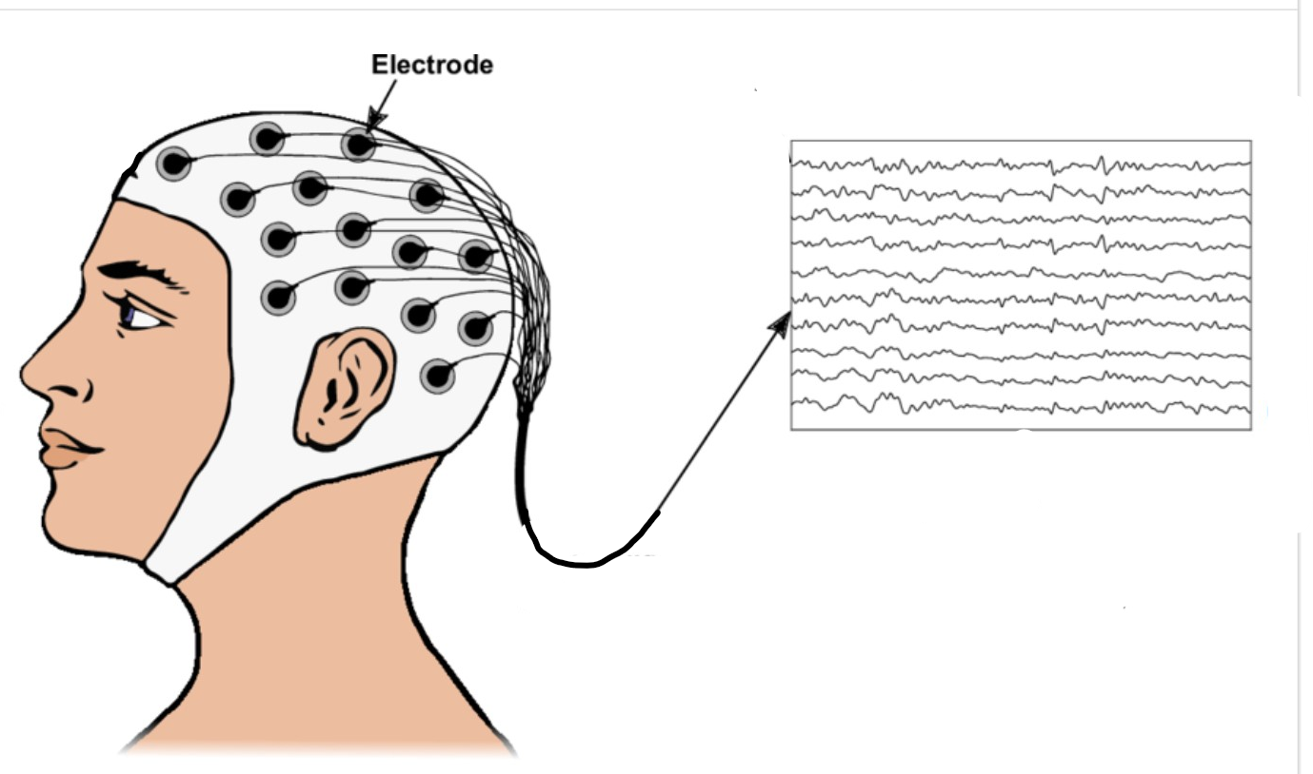
DATASET
The CHB MIT dataset is a publicly accessible dataset. This dataset consists a count of 23 pediatric patients at the Children’s Hospital Boston (CHB). Out of these 23 patients, seventeen girls aged 1.5-19 years, five boys aged 3-22 years. The Electroencephalogram (EEG) is recorded with the help of electrodes placed on head.
Platform : Google Collab IDE
Dataset : CHB MIT ( 42.2 GB)
Language: Python 3.9
Notes:
This data set is developed by CHB and is collected by MIT researchers and it is publicly aviable and accessible dataset it consists of 23 …….

Slide 7
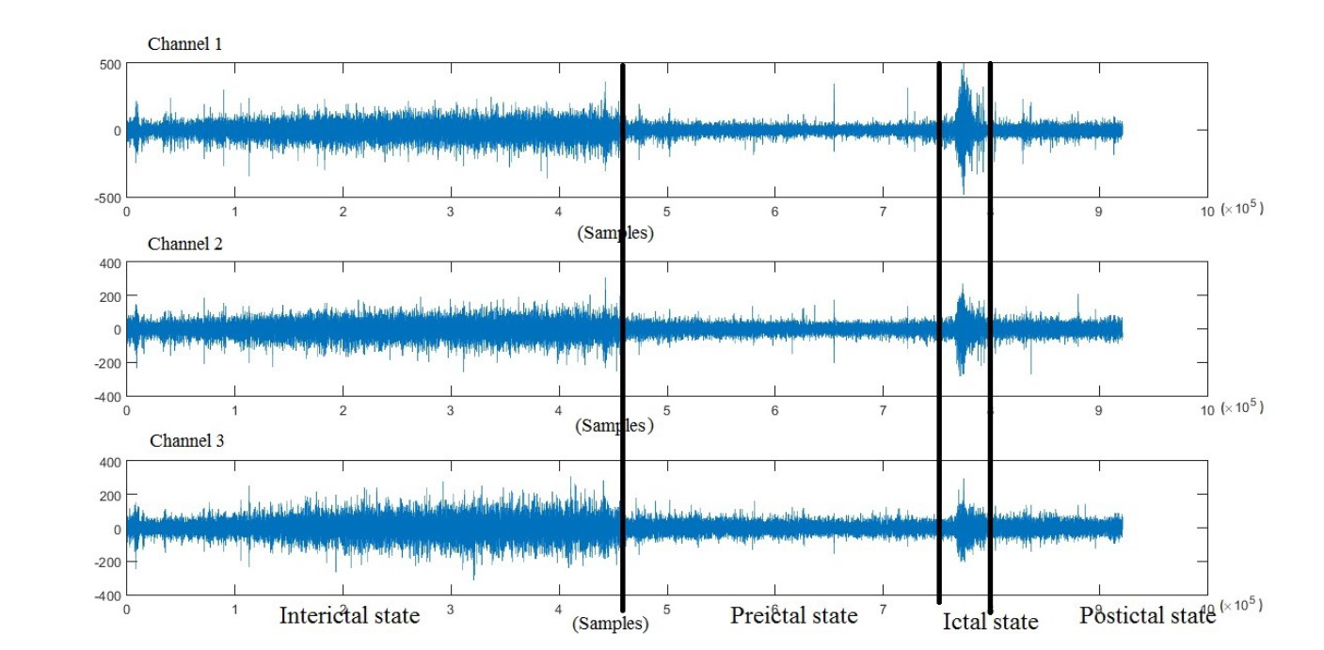
EEG DATA OF CHB MIT DATASET

Slide 8
TERMINOLOGY
Ictal state: Period of beginning and ending of the seizure.
Preictal state: Period before a seizure actually takes place.(Usually 30 min)
Interictal state: Period of leisure or period between seizures.
Postictal state: Period right after the seizure.

Slide 9
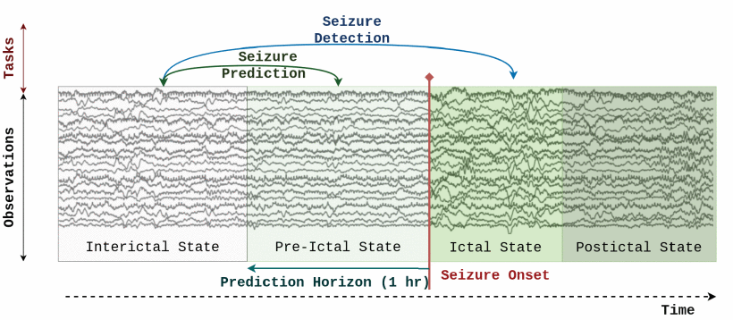

Slide 10
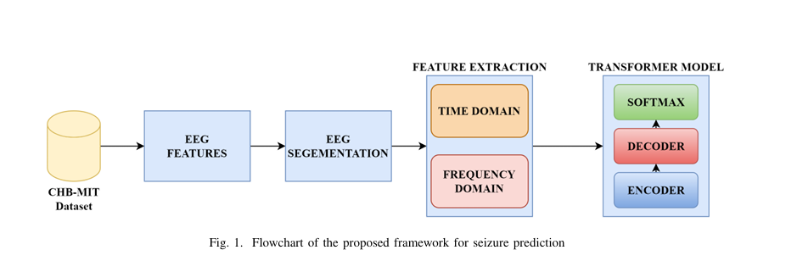
FRAMEWORK
Short Time Fourier transform

Slide 11



Pre-processing
Non Overlapping Window Selection
The long EEG data is divided into 30-sec non overlapping window
Bandpass Filter
These non overlapping signal data is now subjected to bandpass filter to eliminate noise and discard outliers.
Short Time Fourier Transformation
These cleaned data is now subjected to STFT to discover Time domain and Frequency domain data.

Slide 12
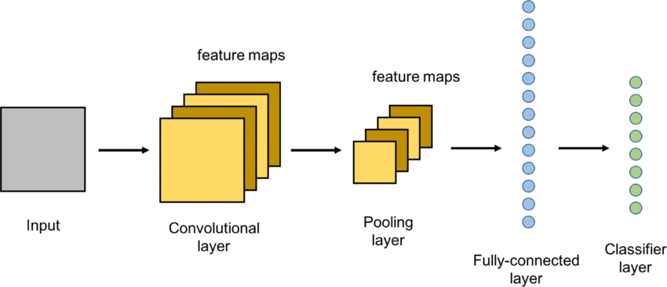
FEATURE EXTRACTION
For extracting features from an image CNN is used.

Slide 13
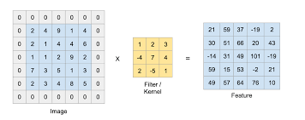
If we have large number of features it will be difficult to train data so we use CNN to reduce the number of parameters to train.
CNN uses filters that detect patterns/features.
CONVOLUTION LAYER :
This layer is used to identify edges and features.The filters used in this layer work as horizontal edge detectors,vertical edge detectors.One single layer consists of different filters.Different filters detect different edges.Each filter ouput gives one image.
If covolution is performed directly there may be loss in information as the corner points are not getting touched so we do padding and perform convolution.

Slide 14
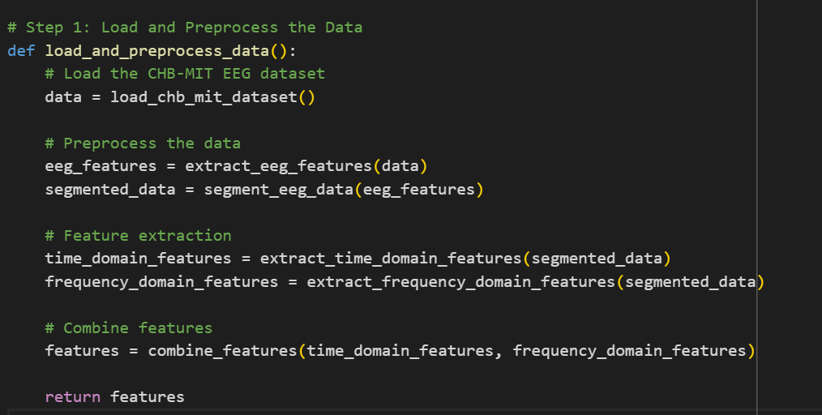
Pseudo Code for Data Preprocessing

Slide 15
CLASSIFICATION
After extracting features using CNN we need to classify them into pre-ictal and inter-ictal states.For classifying we use Transformer Model
Self-Attention Mechanism
Parallelization and Efficiency
Encoder-Decoder Structure
Positional Encoding

Slide 16
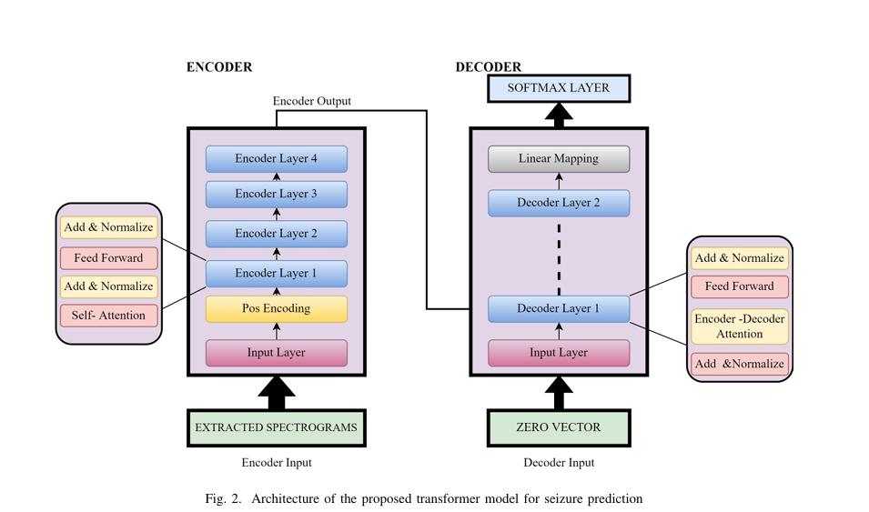
TRANSFORMER ARCHITECTURE

Slide 17
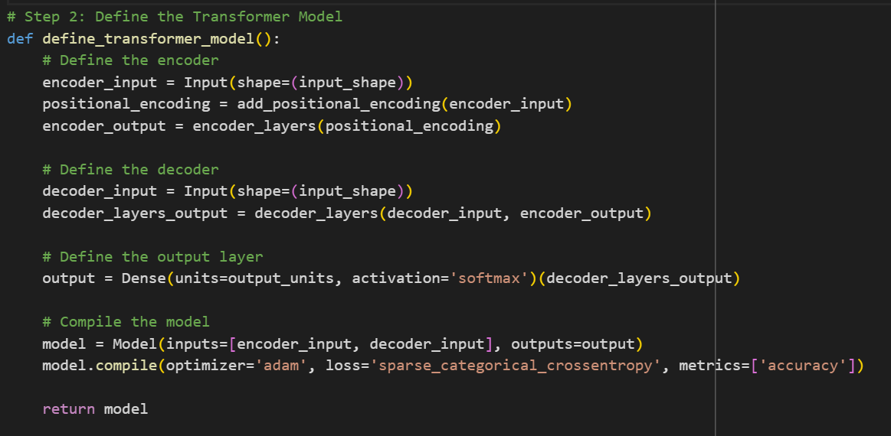
Pseudo Code

Slide 18
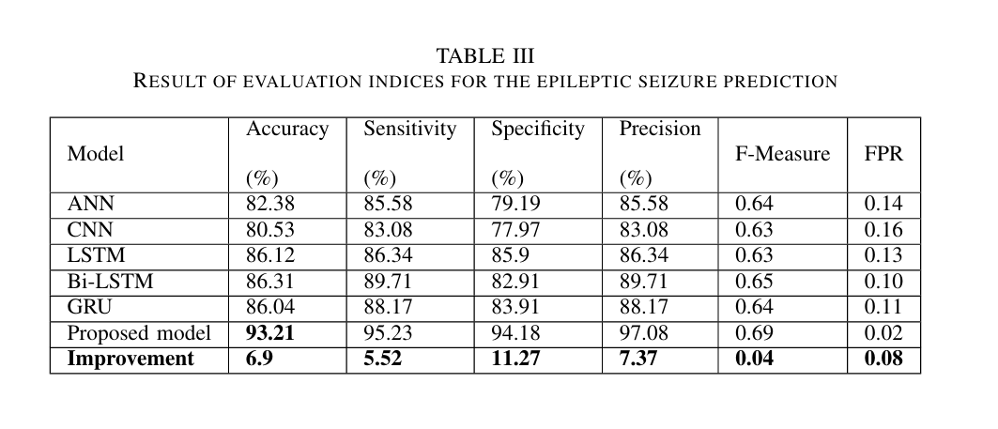
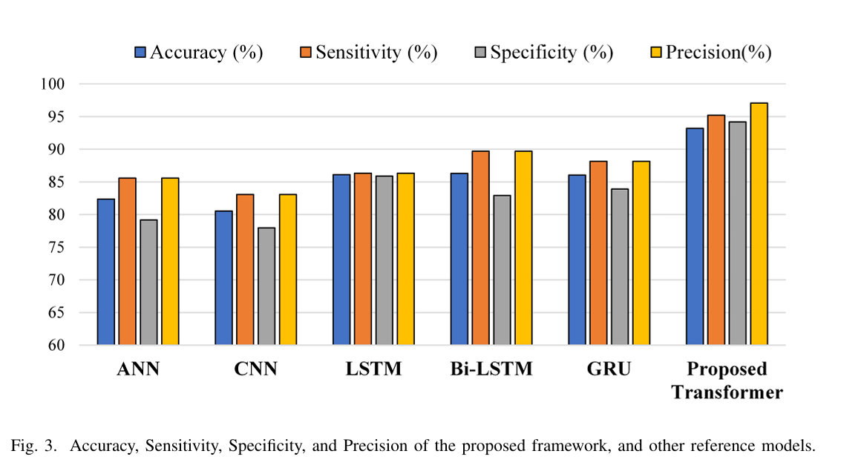
RESULTS

Slide 19
RESULTS
Superior Performance: The transformer model significantly outperforms traditional models (ANN, CNN, LSTM, Bi-LSTM, GRU)
in accuracy (93.21%), sensitivity (95.23%), specificity (94.18%), and precision (97.08%).
Improved Specificity and Sensitivity: The model shows notable improvements, with 11.27% higher specificity and 5.52%
higher sensitivity than the next best models, effectively reducing false positives and negatives.
Training Efficiency: Unlike Bi-LSTM, LSTM, and GRU, which have longer training times due to sequential processing
the transformer model leverages GPU parallelization, making it more efficient for real-world applications.

Slide 20
RESULTS
Sensitivity: 95.2%
Specificity: 94.18%
Accuracy 93.21%
False Positive Rate (FPR): 0.02
Superior performance over ANN, CNN, LSTM, Bi-LSTM, and GRU models.

Slide 21
REFERENCES
Usman, S. M., Khalid, S., & Aslam, M. H. (2020). Epileptic seizures prediction using deep learning techniques. Ieee Access, 8, 39998-40007.
Bhattacharya, A., Baweja, T., & Karri, S. P. K. (2022). Epileptic Seizure Prediction Using Deep Transformer Model. International Journal of Neural Systems, 32(02), 2150058.
Dissanayake, T., Fernando, T., Denman, S., Sridharan, S., & Fookes, C. (2021). Deep learning for patient-independent epileptic seizure prediction using scalp EEG signals. IEEE Sensors Journal, 21(7), 9377-9388.
Liu, G., Zhou, W., & Geng, M. (2020). Automatic seizure detection based on S-transform and deep convolutional neural network. International journal of neural systems, 30(04), 1950024.
Usman, S. M., Khalid, S., & Bashir, S. (2021). A deep learning based ensemble learning method for epileptic seizure prediction. Computers in Biology and Medicine, 136, 104710.

